Slide 1
The Lion, the Witch, and the Wardrobe
Read the excerpts and/or view the film clips related to hospitality in The Lion, the Witch, and the Wardrobe.
Consider what these scenes reveal to you about the meaning(s) of hospitality, its relationship to good and evil, and how we can apply this to our understanding of “the good life.”

Slide 2
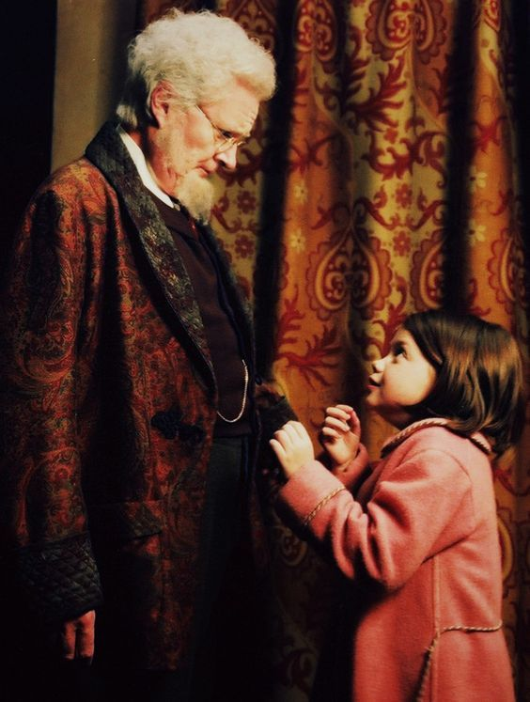
Professor Kirke
Watch the video clip of the beginning of the story and the end of the story. Consider what it shows you about hospitality. What kind of hospitality do you see or not see?
Notes:
Image Pinterest

Slide 3
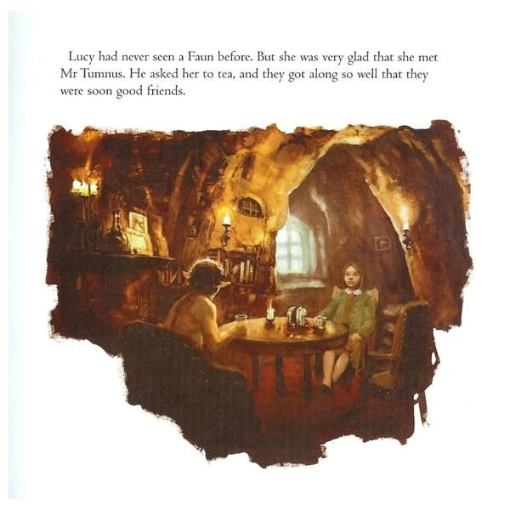
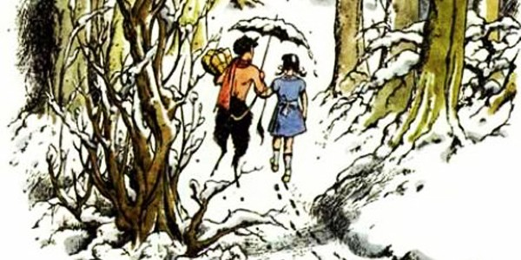
Mr. Tumnus
When Lucy enters Narnia through the wardrobe, she meets Mr. Tumnus. Read pages 5-8 as found online. Discuss what this scene shows you about what hospitality is and is not. How is it connected to good and evil?
Notes:
Image https://fictionfanblog.wordpress.com/2015/07/17/the-lion-the-witch-and-the-wardrobe-by-cs-lewis-narrated-by-michael-york/
Image https://movies-other.ambient-mixer.com/mr--tumnus--house

Slide 4
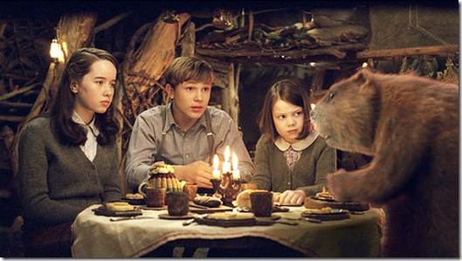
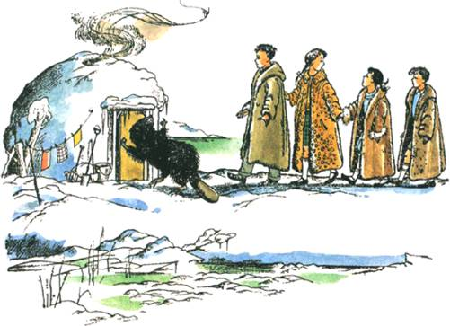
Mr. and Mrs. Beaver
When all four of the children find their way through the wardrobe and into Narnia, they meet Mr. Beaver, who motions to them to quietly follow until it is safe. Read p. 31-32 online for a description of the hospitality of Mr. and Mrs. Beaver.
Notes:
Image https://www.e-reading.club/bookreader.php/71014/Lewis_-_The_Lion%2C_the_Witch_and_the_Wardrobe.html
Image http://narnia.wikia.com/wiki/Beaver%27s_Dam
Image http://merecslewis.blogspot.com/2010/10/tell-us-about-aslan.html

Slide 5
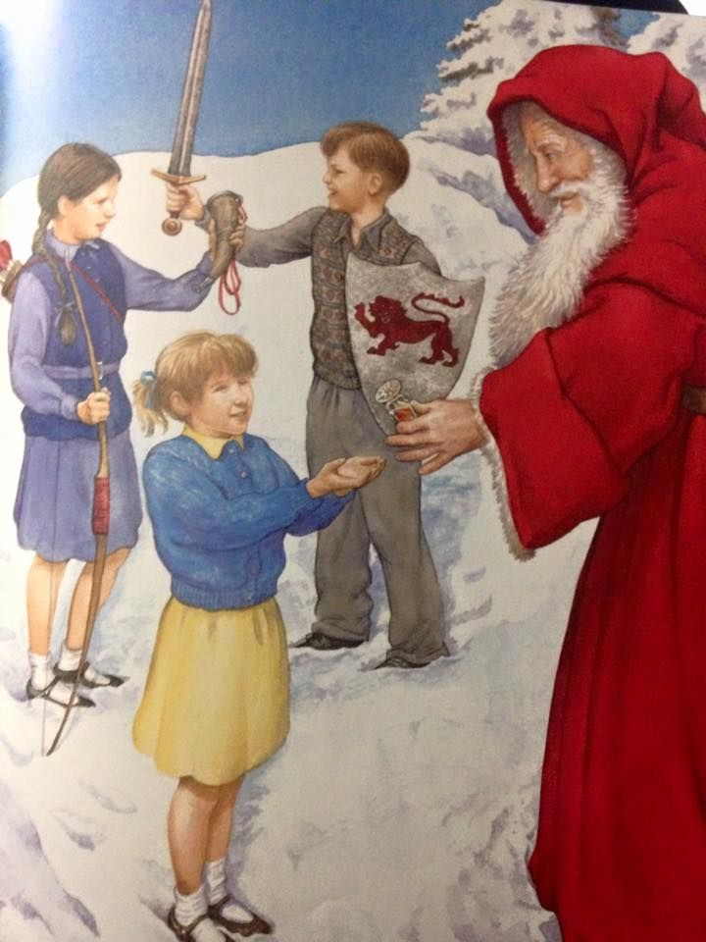
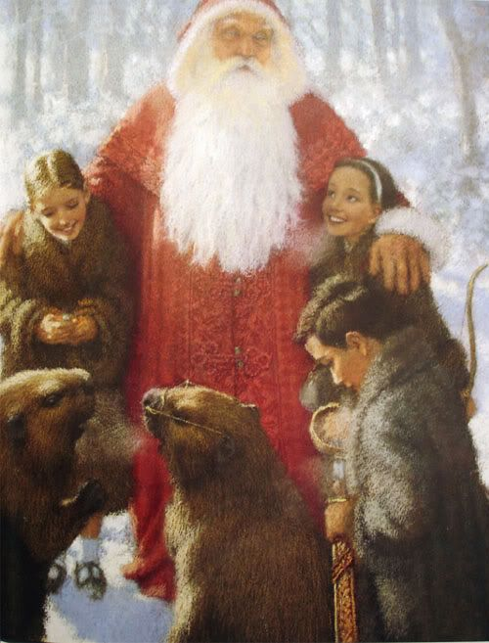
Father Christmas
In Narnia, it has been “always winter but never Christmas” because the White Witch has held power over the land. As her power begins to weaken, Father Christmas appears. Watch this short scene and consider what it shows you about hospitality.
Notes:
Image Pinterest

Slide 6
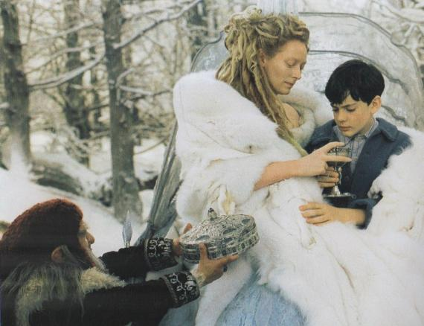
The Witch
But behind him, on a much higher seat in the middle of the sledge sat a very different person - a great lady, taller than any woman that Edmund had ever seen. She also was covered in white fur up to her throat and held a long straight golden wand in her right hand and wore a golden crown on her head. Her face was white - not merely pale, but white like snow or paper or icing-sugar, except for her very red mouth. It was a beautiful face in other respects, but proud and cold and stern.
Read Chapter Four, p. 14-16, which you can find online.
Notes:
Image http://vignette2.wikia.nocookie.net/narnia/images/e/e5/Edmundjadisturkishdelight.JPG/revision/latest?cb=20130613123342

Slide 7

Aslan
Near the end of the story, Aslan, the great lion and redeemer, dies in place of Edmund and
defeats evil with “a magic deeper still.” Read this passage and consider the nature of hospitality as well as the role Aslan plays in it.
That night they slept where they were. How Aslan provided food for them all I don't
know; but somehow or other they found themselves all sitting down on the grass to a fine
high tea at about eight o'clock. Next day they began marching eastward down the side of
the great river. And the next day after that, at about teatime, they actually reached the
mouth. The castle of Cair Paravel on its little hill towered up above them; before them
were the sands, with rocks and little pools of salt water, and seaweed, and the smell of the
sea and long miles of bluish-green waves breaking for ever and ever on the beach. And
oh, the cry of the sea-gulls! Have you heard it? Can you remember?
That evening after tea the four children all managed to get down to the beach again and
get their shoes and stockings off and feel the sand between their toes. But next day was
more solemn.
Notes:
Image http://narnia.wikia.com/wiki/Aslan

Slide 8
For then, in the Great Hall of Cair Paravel - that wonderful hall with the
ivory roof and the west wall hung with peacock's feathers and the eastern door which
looks towards the sea, in the presence of all their friends and to the sound of trumpets,
Aslan solemnly crowned them and led them to the four thrones amid deafening shouts of,
"Long Live King Peter! Long Live Queen Susan! Long Live King Edmund! Long Live
Queen Lucy!"
"Once a king or queen in Narnia, always a king or queen. Bear it well, Sons of Adam!
Bear it well, Daughters of Eve!" said Aslan.
And through the eastern door, which was wide open, came the voices of the mermen and
the mermaids swimming close to the shore and singing in honour of their new Kings and
Queens.
So the children sat on their thrones and sceptres were put into their hands and they gave
rewards and honours to all their friends, to Tumnus the Faun, and to the Beavers, and
Giant Rumblebuffin, to the leopards, and the good centaurs, and the good dwarfs, and to
the lion. And that night there was a great feast in Cair Paravel, and revelry and dancing,
and gold flashed and wine flowed, and answering to the music inside, but stranger,
sweeter, and more piercing, came the music of the sea people.

Slide 9
References
Baehr, T. & Baehr, J. (2005). Narnia Beckons: C. S. Lewis's the Lion, the Witch, And the Wardrobe And Beyond. B&H Publishing.
Glyer, D.P. (2015). Intellectual hospitality. APU Life. Retrieved from https://www.apu.edu/articles/intellectual-hospitality/
Glyer, D. P. (2014). C.S. Lewis at Table with Dante and Zeus. C. S. Lewis Summer Institute at Oxbridge. Retrieved from https://www.youtube.com/watch?time_continue=504&v=r7GTtZEW9Kk
Schakel, P. (2017, December 1). C.S. Lewis. Encyclopedia Britannica. Retrieved from https://www.britannica.com/biography/C-S-Lewis
"The Lion, the Witch and the Wardrobe." Novels for Students. Retrieved from Encyclopedia.com: http://www.encyclopedia.com/arts/educational-magazines/lion-witch-and-wardrobe

